Slide 1

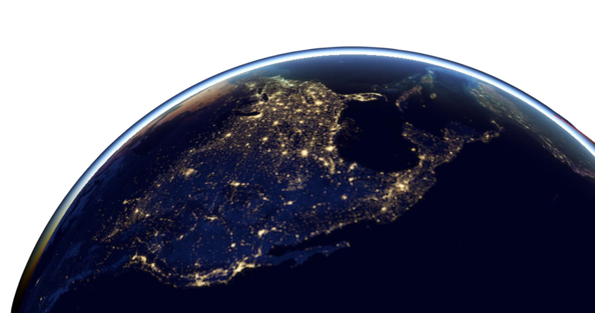
Visualising the space station in 3D
The Trackers

Slide 2
Project objective:
Build a web application to track the ISS in 3D space with visualisations of Earth and the orbit of the station.

Slide 3
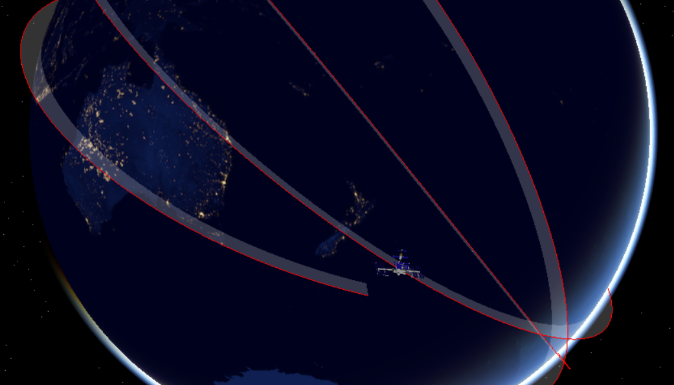
Demo
https://binaryfunt.github.io/iss-tracker/

Slide 4
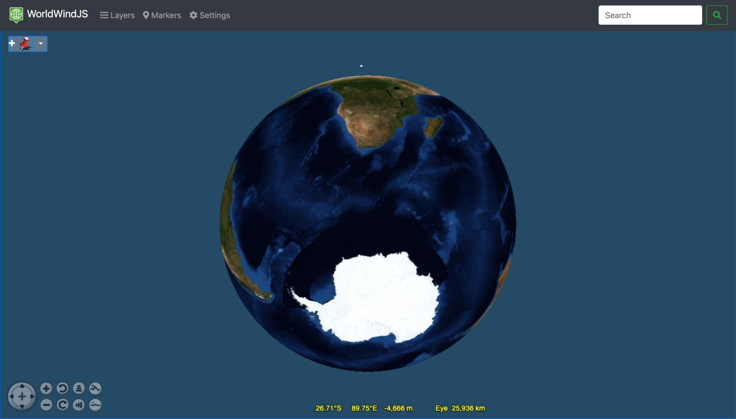
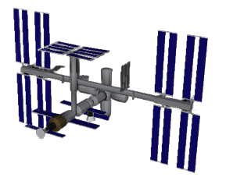
Initial steps
Our first step was to create a simple web app with an interactive 3D globe. We did this using NASA’s open source virtual globe, WorldWind. This gave us a base from which we could add layers and markers as we wanted.
We converted a NASA 3D model of the ISS into a compatible format using Blender.

Slide 5
Tracking the ISS
TLE data
SGP4 propagator
We fetch two-line elements (TLE) data from an API.
This data provides the parameters that define the orbit of the ISS, updated daily.
We plug the TLE data into an open-source library, tle.js. This uses a mathematical model called SGP4 to calculate the current ISS position and the orbital trajectory.
This position is recalculated every second to ensure live tracking.

Slide 6
Advantages
The tracker offers 3-dimensional representations of both the station itself and its position relative to the earth, as opposed to the more common 2-dimensional representation. The user is also able to rotate the globe model in order to follow the ISS’s orbit.
As the tracker is a web application rather than being a desktop application, it is easily accessible from a browser and does not need to be downloaded. This means that users can easily access it at any time.
Over time the tracker should generate interest in the ISS itself as it is an engaging resource for younger users who may have not been previously aware of the ISS.

Slide 7
Future plans
Visibility cone
Users would be able to see the area on the Earth’s surface that the ISS is visible from.
Generalising the model
The model can be generalised for all satellites with available data, orbiting any celestial body.
Increasing scope
The model can be expanded to include satellites that aren’t orbiting a planet, such as the voyager probes.
Increasing Interactivity
Users would be able to spotlight specific bodies or satellites or view a wider, more general image of the solar system and its satellites, or beyond!

